Slide 1
Database System Concepts and Architecture

Slide 2
Outline
Data Models and Their Categories
Schemas, Instances, and States
Three-Schema Architecture
Centralized and Client-Server Architectures
Two-Tier and n-Tier Client/Server Architectures

Slide 3
Data Models
Data Model:
  A set of concepts to describe the structure of a database, the operations for manipulating these structures, and certain constraints that the database should obey.
  Data model tells how the logical structure of a database.
  Data models define how data is connected to each other and how it will be processed and stored inside the system.
  A model is a representation of reality, 'real world' objects and events, associations. It is an abstraction that concentrates on the essential, inherent aspects an organization

Slide 4
Data Models(continued)
  A data model represents the organization itself. It should provide the basic concepts and notations that will allow database designers and end users unambiguously and accurately to communicate their understanding of the organizational data.
Data Model can be defined as an integrated collection of concepts for describing and manipulating data, relationships between data, and constraints on the data in an organization

Slide 5
Data Models(continued)
Data Model Structure and Constraints:
  Constructs are used to define the database structure
  Constructs typically include elements (and their data types) as well as groups of elements (e.g. entity, record, table), and relationships among such groups
  Constraints specify some restrictions on valid data; these constraints must be enforced at all times

Slide 6
Data Models(continued)
A data model comprises of three components:
  A structural part, consisting of a set of rules according to which databases can be constructed.
  A manipulative part, defining the types of operation that are allowed on the data (this includes the operations that are used for updating or retrieving data from the database and for changing the structure of the database).
  Possibly a set of integrity rules, which ensures that the data is accurate.

Slide 7
Data Models(continued)
Data Model Operations:
  These operations are used for specifying database retrievals and updates by referring to the constructs of the data model.
  Operations on the data model may include basic model operations (e.g. generic insert, delete, update) and user-defined operations (e.g. compute_student_gpa, update_inventory)

Slide 8
Categories of Data Models
Conceptual (high-level, semantic) data models:
  Provide concepts that are close to the way many users perceive data.
    (Also called entity-based or object-based data models.)
  Object based data models use concepts such as entities, attributes, and relationships.
  An entity is a distinct object (a person, place, concept, and event) in the organization that is to be represented in the database.
An attribute is a property that describes some aspect of the object that we wish to record, and a relationship is an association between entities.
Some of the more common types of object based data model are Entity Relationship Data Model, Object Oriented Data Model, Semantic Data Model, Functional Data Model

Slide 9
Categories of Data Models
A conceptual schema is a high-level description of a business's informational needs.
It typically includes only the main concepts and the main relationships among them.
Typically this is a first-cut model, with insufficient detail to build an actual database.
This level describes the structure of the whole database for a group of users.
Specifically, it describes the things of significance to an organization (entity classes), about which it is inclined to collect information, and characteristics of (attributes) and associations between pairs of those things of significance (relationships).

Slide 10
Categories of Data Models
Physical (low-level, internal) data models:
Provide concepts that describe details of how data is stored in the computer, representing information such as record structures, record ordering, and access paths
There are not as many physical data models as logical data models, the most common one being the Unifying Model.
A physical data model (or database design) is a representation of a data design which takes into account the facilities and constraints of a given database management system.

Slide 11
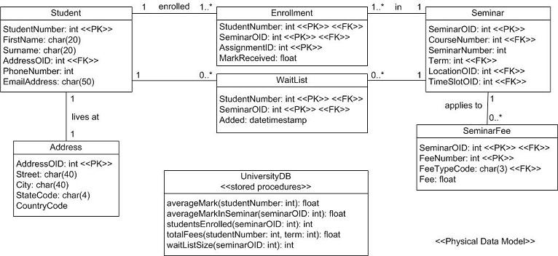

Slide 12
Categories of Data Models
Implementation (representational) data models:
Provide concepts that fall between the above two, used by many commercial DBMS implementations (e.g. relational data models used in many commercial systems).

Slide 13
Schema versus Instances
Database Schema:
  The description of a database.
  Includes descriptions of the database structure, data types, and the constraints on the database.
Schema Diagram:
  An illustrative display of (most aspects of) a database schema.
Schema Construct:
  A component of the schema or an object within the schema, e.g., STUDENT, COURSE.

Slide 14
Schemas versus Instances
Database State:
  The actual data stored in a database at a particular moment in time. This includes the collection of all the data in the database.
  Also called database instance (or occurrence or snapshot).
    The term instance is also applied to individual database components, e.g. record instance, table instance, entity instance

Slide 15
Database Schema vs. Database State
Database State:
  Refers to the content of a database at a moment in time.
Initial Database State:
  Refers to the database state when it is initially loaded into the system.
Valid State:
  A state that satisfies the structure and constraints of the database.

Slide 16
Database Schema vs. Database State
The distinction between database schema and database state is very important.
When we define a new database, we specify its database schema only to the DBMS. At this point, the corresponding database state is the empty state with no data.
We get the initial state of the database when the database is first populated or loaded with the initial data. From then on, every time an update operation is applied to the database, we get another database state.

Slide 17
Database Schema vs. Database State
The DBMS is partly responsible for ensuring that every state of the database is a valid state-that is, a state that satisfies the structure and constraints specified in the schema.
The DBMS stores the descriptions of the schema constructs and constraints-also called the meta-data-in the DBMS catalog so that DBMS software can refer to the schema whenever it needs to.
The schema is sometimes called the intension, and a database state an extension of the schema.

Slide 18
Database Schema vs. Database State (cntd)
Distinction
  The database schema changes very infrequently.
  The database state changes every time the database is updated.
Schema is also called intension.
State is also called extension.

Slide 19

Example of a Database Schema

Slide 20

Example of a database state

Slide 21
Three-Schema Architecture
Proposed to support DBMS characteristics of:
  Program-data independence.
  Support of multiple views of the data.

Slide 22
Three-Schema Architecture
Defines DBMS schemas at three levels:
  Internal schema at the internal level to describe physical storage structures and access paths (e.g indexes).
    Typically uses a physical data model.
  Conceptual schema at the conceptual level to describe the structure and constraints for the whole database for a community of users.
    Uses a conceptual or an implementation data model.
  External schemas at the external level to describe the various user views.
    Usually uses the same data model as the conceptual schema.

Slide 23

The three-schema architecture

Slide 24
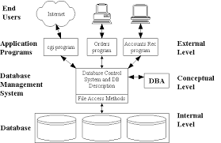

Slide 25
Three-Schema Architecture
Mappings among schema levels are needed to transform requests and data.
  Programs refer to an external schema, and are mapped by the DBMS to the internal schema for execution.
  Data extracted from the internal DBMS level is reformatted to match the user’s external view (e.g. formatting the results of an SQL query for display in a Web page)

Slide 26
Centralized and
Client-Server DBMS Architectures
Centralized DBMS:
  Combines everything into single system including- DBMS software, hardware, application programs, and user interface processing software.
  User can still connect through a remote terminal – however, all processing is done at centralized site.

Slide 27
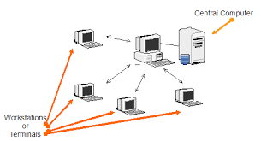
Centralized DBMS

Slide 28

A Physical Centralized Architecture

Slide 29
Basic 2-tier Client-Server Architectures
Specialized Servers with Specialized functions
  Print server
  File server
  DBMS server
  Web server
  Email server
Clients can access the specialized servers as needed

Slide 30
2-tier Client-Server Architectures
A two-tier client/server is a type of multi-tier computing architecture in which an entire application is distributed as two distinct layers or tiers.
It divides the application logic, data and processing between client and server devices.
A two-tier client/server works when most or all of the application logic and data is hosted on a server. The client integrates with the presentation layer and accesses the server for application specific tasks and processing.

Slide 31

Logical two-tier client server architecture

Slide 32
Clients
Provide appropriate interfaces through a client software module to access and utilize the various server resources.
Clients may be diskless machines or PCs or Workstations with disks with only the client software installed.
Connected to the servers via some form of a network.
  (LAN: local area network, wireless network, etc.)

Slide 33
DBMS Server
Provides database query and transaction services to the clients
Relational DBMS servers are often called SQL servers, query servers, or transaction servers
Applications running on clients utilize an Application Program Interface (API) to access server databases via standard interface such as:
  ODBC: Open Database Connectivity standard
  JDBC: for Java programming access
Client and server must install appropriate client module and server module software for ODBC or JDBC

Slide 34
Two Tier Client-Server Architecture
A client program may connect to several DBMSs, sometimes called the data sources.
In general, data sources can be files or other non-DBMS software that manages data.
Other variations of clients are possible: e.g., in some object DBMSs, more functionality is transferred to clients including data dictionary functions, optimization and recovery across multiple servers, etc.

Slide 35
Two Tier Client-Server Architecture
A two-tier client/server is a type of multi-tier computing architecture in which an entire application is distributed as two distinct layers or tiers.
It divides the application logic, data and processing between client and server devices.
A two-tier client/server works when most or all of the application logic and data is hosted on a server.
For example, the core application and data are installed at a central server. One or more client devices uses its client-end application to request data or processes from the server

Slide 36
Three Tier Client-Server Architecture
Common for Web applications
Intermediate Layer called Application Server or Web Server:
  Stores the web connectivity software and the business logic part of the application used to access the corresponding data from the database server
  Acts like a conduit for sending partially processed data between the database server and the client.
Three-tier Architecture Can Enhance Security:
  Database server only accessible via middle tier
  Clients cannot directly access database server

Slide 37

Three-tier client-server architecture

Slide 38
End

